Slide 1
Basic Probability Concepts, Probability Distributions

Slide 2
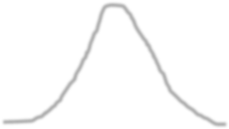
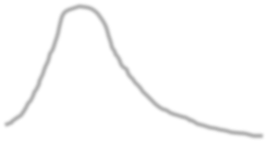
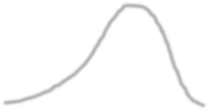
The Central Tendencies
Identify where the MODE, MEDIAN and MEAN lie in the below distributions.
Mode
Mode
Mode
Mean
Mean
Median
Median Mean
Median

Slide 3
The Central Tendencies – Recent Interview Question
For the dataset, 6, 12, 4, 10, 8, the median is
• 8
• 7
• 10
• 6
Ans: 8

Slide 4
Measures of Spread – Recent Interview Question
The spread of the data in a dataset could be studied using __________
Interquartile range
Variance
Standard Deviation
Range (max-min)
All of the above
Ans: All of the above

Slide 5
Given the numbers are 45, 78, 32, 89, 67, 54, the second quartile is: • 56.5 • 62 • 66 • 67 Ans: 62
Measures of Spread – Recent Interview Question

Slide 6
Measures of Spread – Recent Interview Question
Which of the following plot uses the interquartile range
Scatterplot
Histogram
Lineplot
Boxplot
All of the above
Ans: Boxplot

Slide 7
Measures of Spread – Recent Interview Question
What term would best describe the shape of the given boxplot?
Symmetric
Skewed with right tail
Skewed with lest tail
Normal

Slide 8
Data Types – Recent Interview Question
A sample of 350 New York City apartments is surveyed, and various characteristics are noted. Which of the following statements is correct?
The number of bedrooms in an apartment is a discrete variable
The apartment's location (recorded as “Downtown”, “Uptown”, “Midtown”) is nominal level data
The rent amount is an ordinal level variable

Slide 9
Measures of Spread (Dispersion)
We studied Quartiles in depth and mentioned Deciles and Percentiles in passing.
However, just as Quartiles divide data into 4 equal parts, Deciles divide it into 10 equal parts and Percentiles into 100 equal parts.
Given the above, find the 25th, 50th, 75th and the 90th percentiles for the top 16 global marketing sectors for advertising spending for a recent year according to Advertising Age. Also, find Q2 and IQR. Data in next slide.

Slide 10
Sector | Ad spending (in $ million)
Automotive | 14500
Personal Care | 12200
Entertainment and Media | 9850
Food | 8640
Drugs | 8320
Electronics | 4700
Soft Drinks | 4530
Retail | 4200
Restaurants | 4150
Cleaners | 4010
Computers | 3780
Telephone | 3050
Financial | 2900
Beer, Wine and Liquor | 2500
Candy | 1300
Toys | 750

Slide 11
N=16
90th percentile = ( ^{𝑝∗(𝑛−1)} + 1) = ( ^{90∗(16−1)} + 1)th
100 100
= 15.3
The 90th percentile is between the 15th and 16th values
So 15.3th entry is mid-point between these two = 20331.2

Slide 12
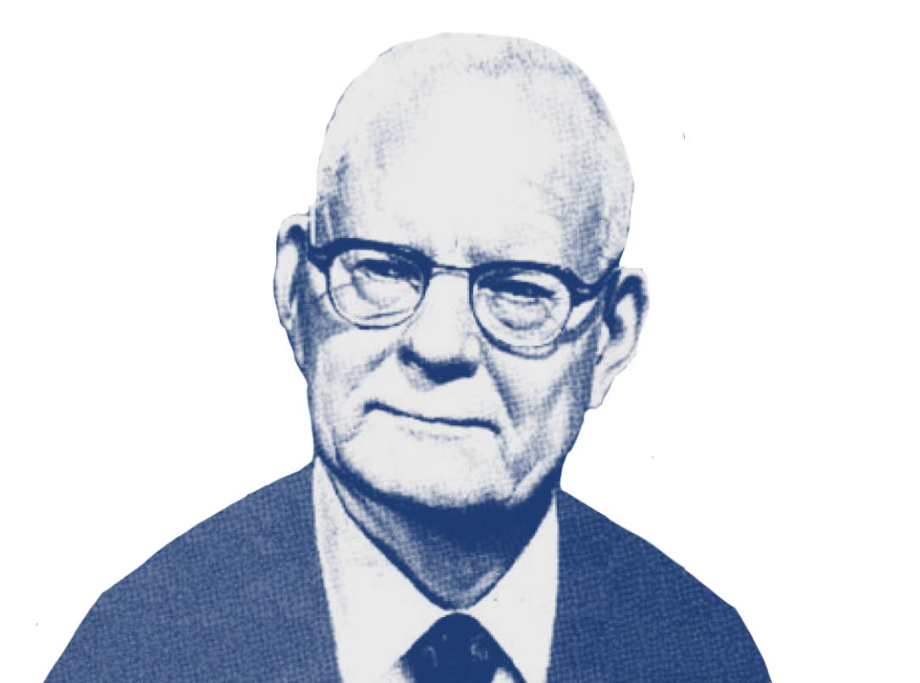
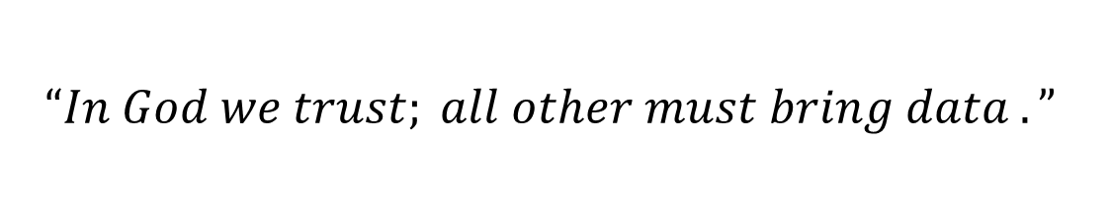
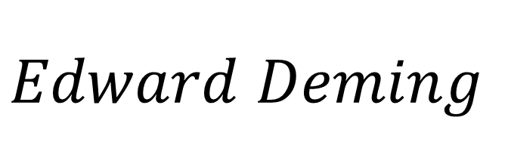
Strategic decisions must be based on hard data
$$“In God we trust; all other must bring data .”$$
$$Edward Deming$$

Slide 13
PROBABILITY BASICS

Slide 14
Understanding Probability
Consider the following statements. How do you interpret “probability” in each one of those? And how is it computed?
Coin Toss – Probability of Head is ½
Weather – Probability of thunderstorm tomorrow is 25%
Cricket– CSK will have less than 25% chance of winning this IPL if Chennai matches get moved to Pune.

Slide 15
Probability vs Statistics
Probability – Predict the likelihood of a future event
Statistics – Analyse the past events
Questions addressed -
Probability – What will happen in a given ideal world?
Statistics – How ideal is the world?

Slide 16
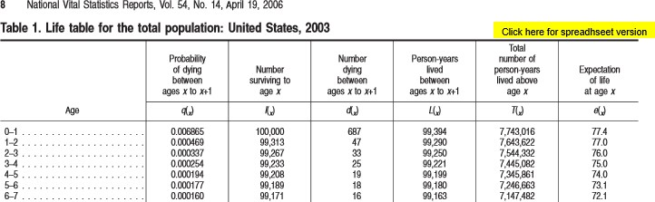
Probability - Applications
Insurance industry uses probabilities in actuarial tables for setting premiums and coverages.

Slide 17
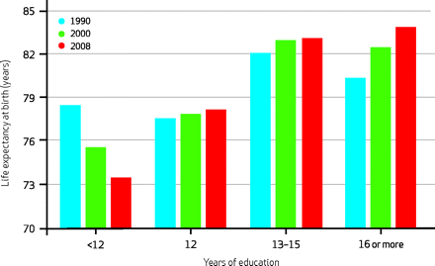
Probability - Applications

Slide 18
Probability - Applications
Gaming industry – Establish charges and payoffs
Manufacturing/Aerospace – Prevent major breakdowns
Business – Deciding on a business proposal based on probability of success vs cost
Risk Evaluation – Scenario analysis

Slide 19
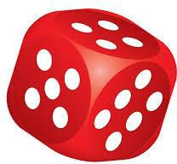
Assigning Probabilities
Classical Method – A priori or Theoretical
Probability can be determined prior to conducting any experiment.
# 𝑜𝑓 𝑜𝑢𝑡𝑐𝑜𝑚𝑒𝑠 𝑖𝑛 𝑤ℎ𝑖𝑐ℎ 𝑡ℎ𝑒 𝑒𝑣𝑒𝑛𝑡 𝑜𝑐𝑐𝑢𝑟𝑠
𝑃 𝐸 =
𝑡𝑜𝑡𝑎𝑙 𝑝𝑜𝑠𝑠𝑖𝑏𝑙𝑒 # 𝑜𝑓 𝑜𝑢𝑡𝑐𝑜𝑚𝑒𝑠
Example: Tossing of a fair die

Slide 20
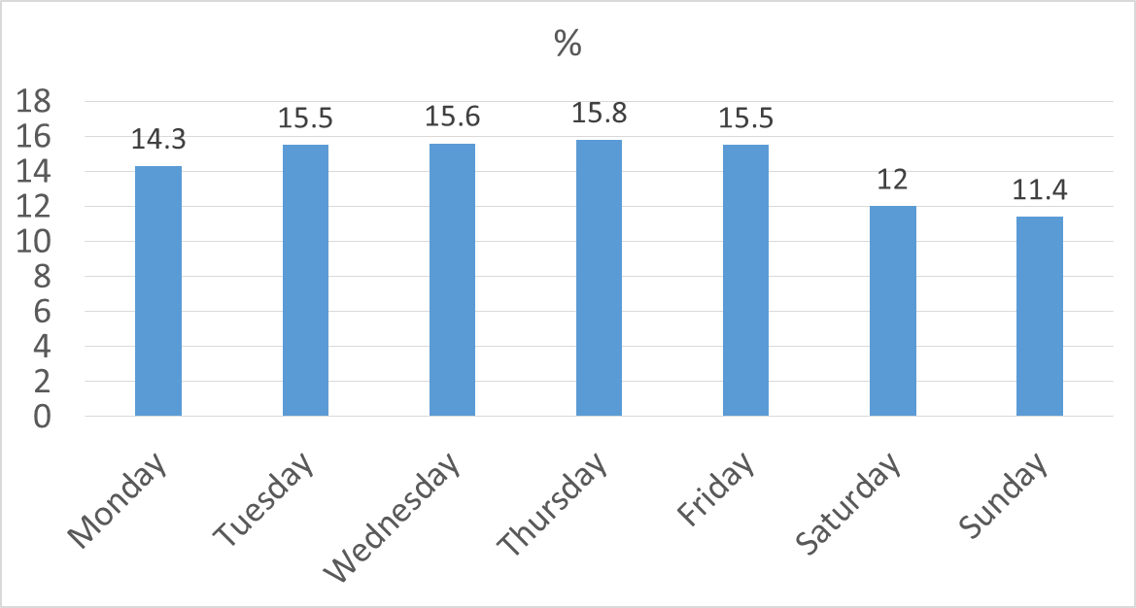
Assigning Probabilities
What is the probability of a baby being born on a Wednesday?
A-priori probability 1/7 = 14.3%
Data from “Risks of Stillbirth and Early Neonatal Death by Day of Week”, by Zhong-Cheng Luo, Shiliang Liu, Russell Wilkins, and Michael S. Kramer, for the Fetal and Infant Health Study Group of the Canadian Perinatal Surveillance System. Data of 3,239,972 births in Canada between 1985 and 1998. The reported percentages do not add up to 100% due to rounding.

Slide 21
Assigning Probabilities
Empirical Method – A posteriori or Frequentist
Probability can be determined post conducting a thought experiment.
# 𝑜𝑓 𝑡𝑖𝑚𝑒𝑠 𝑎𝑛 𝑒𝑣𝑒𝑛𝑡 𝑜𝑐𝑐𝑢𝑟𝑟𝑒𝑑
𝑃 𝐸 =
𝑡𝑜𝑡𝑎𝑙 # 𝑜𝑓 𝑜𝑝𝑝𝑜𝑟𝑡𝑢𝑛𝑖𝑡𝑖𝑒𝑠 𝑓𝑜𝑟 𝑡ℎ𝑒 𝑒𝑣𝑒𝑛𝑡 𝑡𝑜 ℎ𝑎𝑣𝑒 𝑜𝑐𝑐𝑢𝑟𝑟𝑒𝑑
Example: Tossing of a weighted die…well!, even a fair die. The larger the number of experiments, the better the approximation.
This is the most used method in statistical inference.

Slide 22
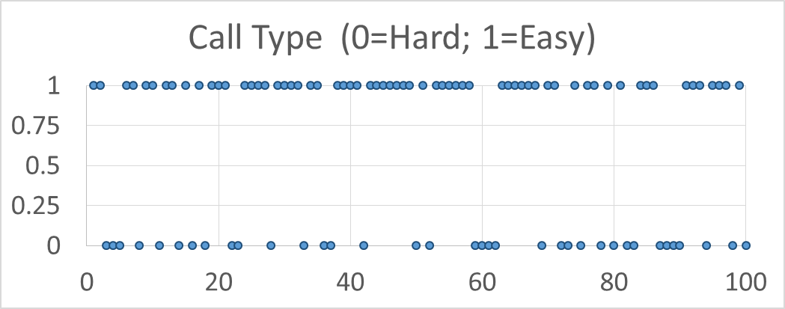
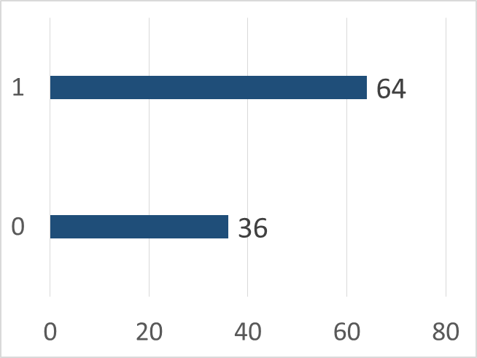
Assigning Probabilities
Empirical Method – A posteriori or Frequentist
100 calls handled by an agent at a call centre

Slide 23
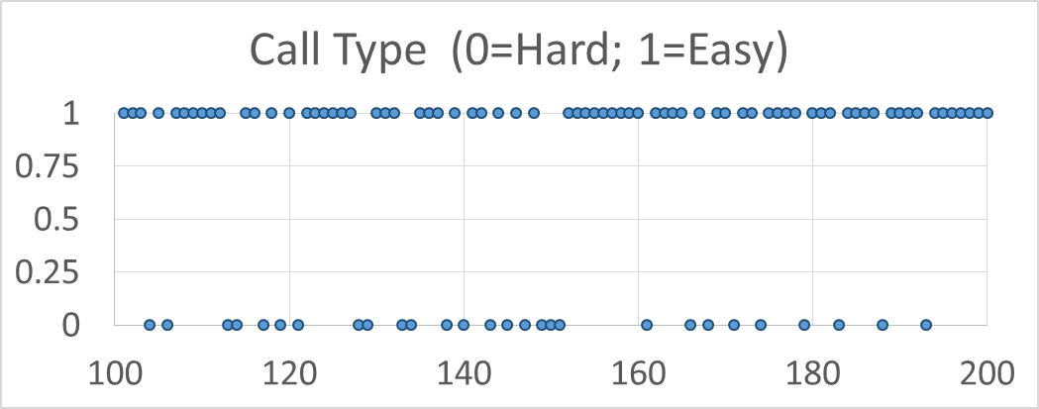
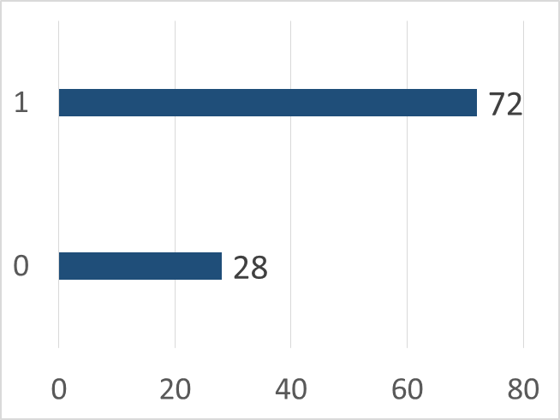
Assigning Probabilities
Empirical Method – A posteriori or Frequentist
Next 100 calls handled by an agent at a call centre

Slide 24
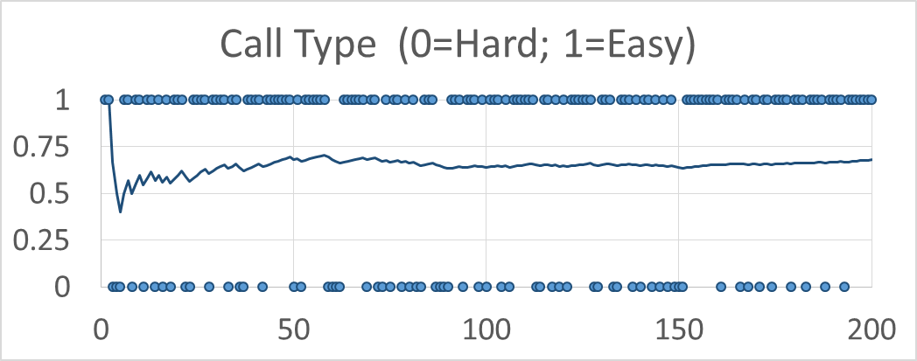
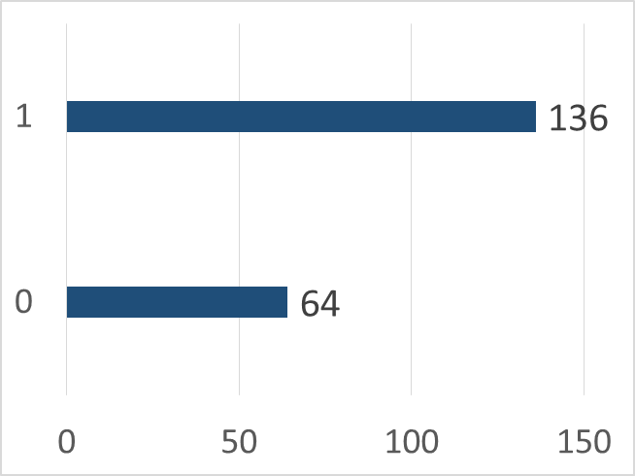
Assigning Probabilities
Empirical Method – A posteriori or Frequentist
Averages over the long run
P(easy) = 0.7

Slide 25
Assigning Probabilities
Subjective Method
Based on feelings, insights, knowledge, etc. of a person.
What is the probability of TDP, DMK and Mamta Banerjee led Third front in making an impact on the upcoming Lok Sabha elections?

Slide 26
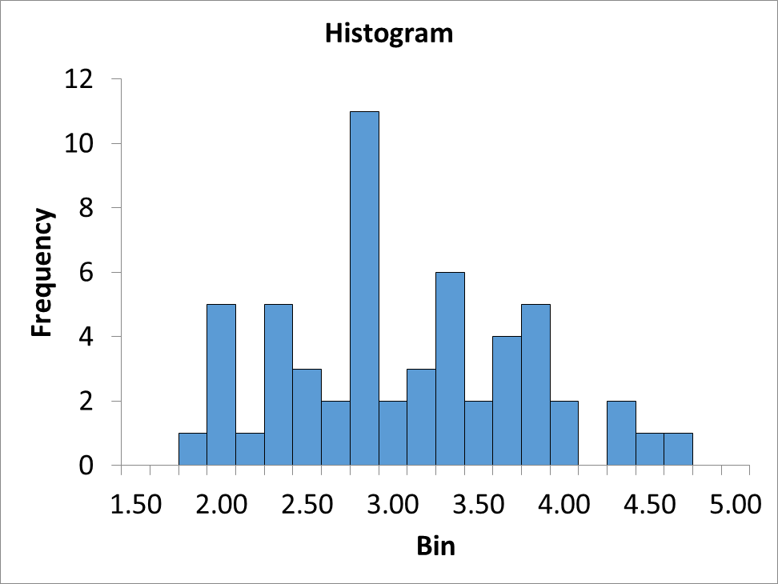
Assigning Probabilities
Subjective Method
2010 rates of growth in US GDP anticipated by 56 economists at the start of 2010.
Does it mean probability of GDP growing by more than 4% is 6/56 = 0.11?
Actual growth 2.5%
Data from: http://projects.wsj.com/econforecast/#ind=gdpa&r=10&e=75 and http://data.worldbank.org/indicator/NY.GDP.MKTP.KD.ZG

Slide 27
Probability - Terminology
Sample Space – Set of all possible outcomes, denoted S. Example:
After 2 coin tosses, the set of all possible outcomes are
{HH, HT, TH, TT}
Event – A subset of the sample space.
An Event of interest might be – HH

Slide 28
Probability - Rules
S
S
A
S
A B
A and B are mutually exclusive
𝑃 (𝐴 𝑜𝑟 𝐵)
= 𝑃 (𝐴) + 𝑃(𝐵)
𝑃(𝑆) = 1
0 ≤ 𝑃(𝐴) ≤ 1
Area of the rectangle denotes sample space, and since probability is associated with area, it cannot be negative.
Mutually Exclusive – If event A happens, event B cannot.

Slide 29
Probability - Rules
S
A B
A and B are not mutually exclusive
𝑃 (𝐴 𝑜𝑟 𝐵)= 𝑃(𝐴) + 𝑃(𝐵)− 𝑃(𝐴 𝑎𝑛𝑑 𝐵)
Example
Event A – Customers who default on loans
Event B – Customers who are High Net Worth Individuals

Slide 30
Probability - Rules
Independent Events – Outcome of event B is not dependent on the outcome of event A.
Probability of customer B defaulting on the loan is not dependent on default (or otherwise) by customer A.
𝑃 (𝐴 𝑎𝑛𝑑 𝐵) = 𝑃 (𝐴) ∗ 𝑃 (𝐵)
If the probability of getting an easy call is 0.7, what is the probability that the next 3 calls will be easy?
𝑃 (𝑒𝑎𝑠𝑦₁ 𝑎𝑛𝑑 𝑒𝑎𝑠𝑦₂ 𝑎𝑛𝑑 𝑒𝑎𝑠𝑦₃) = 0.7³= 0.343

Slide 31
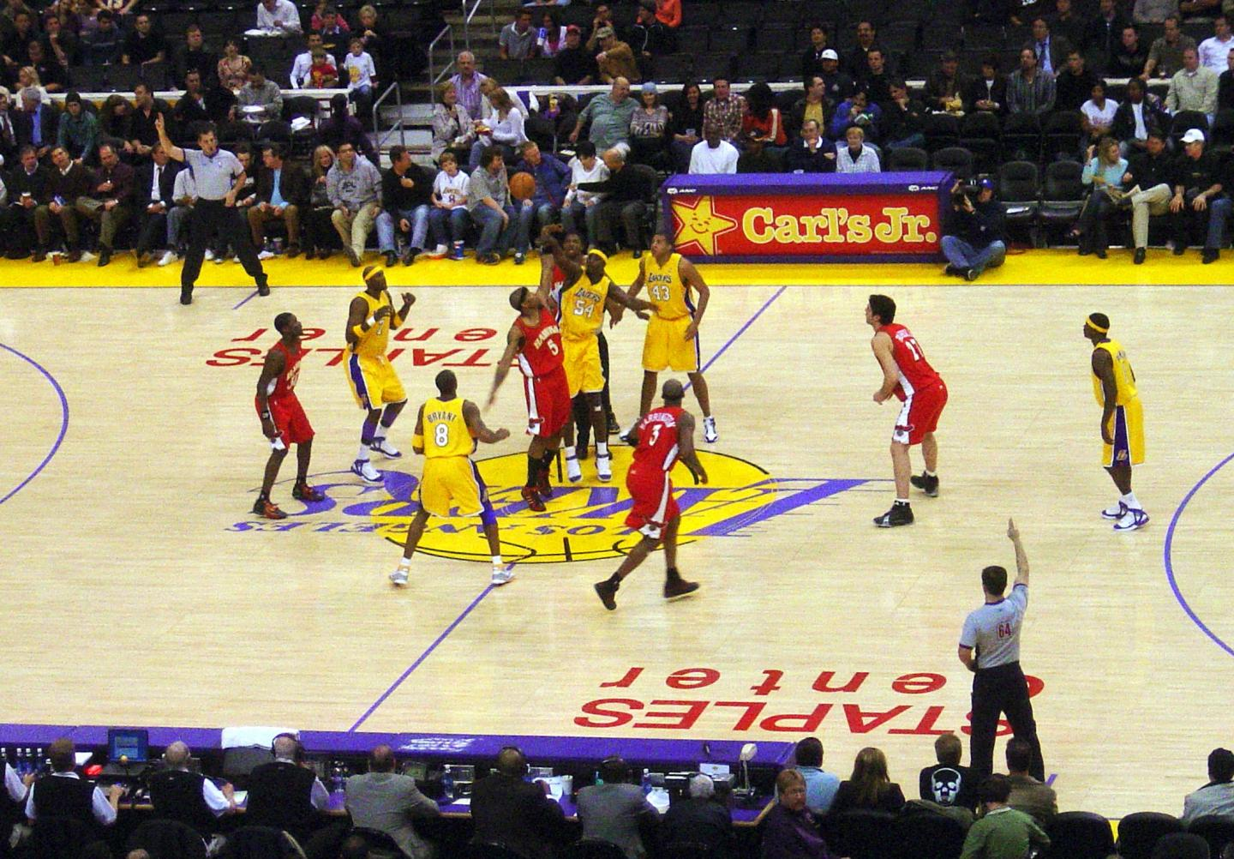
Probability - Questions
A basketball team is down by 2 points with only a few seconds remaining in the game. Given that:
Chance of making a 2-point shot to tie the game = 50%
Chance of winning in overtime = 50%
Chance of making a 3-point shot to win the game = 30%
What should the coach do:
Go for 2- point or 3-point shot?
What are the assumptions, if any?

Slide 32
Probability - Types
Contingency table summarizing 2 variables, Loan Default and Age:
 |  | Age
 |  | Young | Middle-aged | Old | Total
Loan Default | No | 10,503 | 27,368 | 259 | 38,130
 | Yes | 3,586 | 4,851 | 120 | 8,557
 | Total | 14,089 | 32,219 | 379 | 46,687

Slide 33
Probability - Types
Convert it into probabilities:
 |  | Age
 |  | Young | Middle-aged | Old | Total
Loan Default | No | 0.225 | 0.586 | 0.005 | 0.816
 | Yes | 0.077 | 0.104 | 0.003 | 0.184
 | Total | 0.302 | 0.690 | 0.008 | 1.000

Slide 34
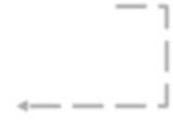
Probability - Types
 |  | Age
 |  | Young | Middle-aged | Old | Total
Loan Default | No | 0.225 | 0.586 | 0.005 | 0.816
 | Yes | 0.077 | 0.104 | 0.003 | 0.184
 | Total | 0.302 | 0.690 | 0.008 | 1.000
Marginal Probability
Probability describing a single attribute.
P(No) = 0.816
P(Old) = 0.008
S
A

Slide 35
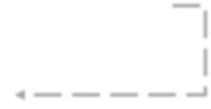
Probability - Types
 |  | Age
 |  | Young | Middle-aged | Old | Total
Loan Default | No | 0.225 | 0.586 | 0.005 | 0.816
 | Yes | 0.077 | 0.104 | 0.003 | 0.184
 | Total | 0.302 | 0.690 | 0.008 | 1.000
Joint Probability
Probability describing a combination of attributes.
P(Yes and Young) = 0.077
S
A B

Slide 36
Probability - Types
 |  | Age
 |  | Young | Middle-aged | Old | Total
Loan Default | No | 0.225 | 0.586 | 0.005 | 0.816
 | Yes | 0.077 | 0.104 | 0.003 | 0.184
 | Total | 0.302 | 0.690 | 0.008 | 1.000
Union Probability
P(Yes or Young) = P(Yes) + P (Young) – P(Yes and Young) =
0.184 + 0.302 – 0.077 = 0.409
S
A B

Slide 37
Probability - Types
 |  | Age
 |  | Young | Middle-aged | Old | Total
Loan Default | No | 0.225 | 0.586 | 0.005 | 0.816
 | Yes | 0.077 | 0.104 | 0.003 | 0.184
 | Total | 0.302 | 0.690 | 0.008 | 1.000
Conditional Probability
Probability of A occurring given that B has occurred.
The sample space is restricted to a single row or column.
This makes rest of the sample space irrelevant.
S
A B

Slide 38
Probability - Types
 |  | Age
 |  | Young | Middle-aged | Old | Total
Loan Default | No | 0.225 | 0.586 | 0.005 | 0.816
 | Yes | 0.077 | 0.104 | 0.003 | 0.184
 | Total | 0.302 | 0.690 | 0.008 | 1.000
Conditional Probability
What is the probability that a person will not default on the loan payment given she is middle-aged?
P(No | Middle-Aged) = 0.586/0.690 = 0.85
Note that this is the ratio of Joint Probability to Marginal
₌ 𝑃(𝐴 𝑎𝑛𝑑 𝐵)
Probability, i.e., 𝑃(𝐴|𝐵)
𝑃(𝐵)
P(Middle-Aged | No) = 0.586/0.816 = 0.72 (Order Matters)

Slide 39
Conditionality Probability
Order Matters
P(Pregnant | Woman)
vs
P(Woman |Pregnant)
Prosecutor’s fallacy
P( Rich | Drug Dealer) vs P(Drug Dealer | Rich)

Slide 40
Conditional Probability – Visualizing using Probability Tables and Venn Diagrams
Probability - Types
 |  | Age
 |  | Young | Middle-aged | Old | Total
Loan Default | No | 10,503 | 27,368 | 259 | 38,130
 | Yes | 3,586 | 4,851 | 120 | 8,557
 | Total | 14,089 | 32,219 | 379 | 46,687
 |  | Age
 |  | Young | Middle-aged | Old | Total
Loan Default | No | 0.225 | 0.586 | 0.005 | 0.816
 | Yes | 0.077 | 0.104 | 0.003 | 0.184
 | Total | 0.302 | 0.690 | 0.008 | 1.000
S
A B

Slide 41


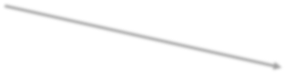

Conditional Probability – Visualizing using Probability Tables and Venn Diagrams
Probability - Types
 |  | Age (Numbers) |  |  |  |  | Age (Probabilities)
 |  | Young | Middle-aged | Old | Total |  | Young | Middle-aged | Old | Total
Loan Default | No | 10,503 | 27,368 | 259 | 38,130 |  | 0.225 | 0.586 | 0.005 | 0.816
 | Yes | 3,586 | 4,851 | 120 | 8,557 |  | 0.077 | 0.104 | 0.003 | 0.184
 | Total | 14,089 | 32,219 | 379 | 46,687 |  | 0.302 | 0.690 | 0.008 | 1.000
10503
= 0.275
Young
38130
38130
= 0.816
46687
Find
No
27368
= 0.718
38130
Middle-aged
P(Old and Yes)
P(Yes and Old)
P(Old)
P(Yes)
P(Old | Yes)
P(Yes | Old)
P(Young | No)
259
= 0.007
38130
Old
Loan Default
3586
= 0.419
Young
8557
8557
= 0.184
Yes
4851
= 0.567
Middle-aged
46687
8557
120
= 0.014
8557
Old

Slide 42
Probability - Types
Attention Check
Identify the type of probability in each of the below cases:
P(Old and Yes)
P(Yes and Old)
P(Old)
P(Yes)
P(Old | Yes)
P(Yes | Old)
P(Young | No)
P(Middle-aged or No)
P(Old or Young)
1 and 2: Joint; 3 and 4: Marginal; 5, 6 and 7: Conditional; 8 and 9: Union
 |  | Age (Probabilities)
 |  | Young | Middle-aged | Old | Total
Loan Default | No | 0.225 | 0.586 | 0.005 | 0.816
 | Yes | 0.077 | 0.104 | 0.003 | 0.184
 | Total | 0.302 | 0.690 | 0.008 | 1.000

Slide 43
Conditional Probability
Probability - Types
𝑃(𝐴 𝑎𝑛𝑑 𝐵)
𝑃 𝐴 𝐵 =
⇒ 𝑃 𝐴 𝑎𝑛𝑑 𝐵
= 𝑃 𝐵
∗ 𝑃 𝐴 𝐵
𝑃(𝐵)
Similarly
𝑃 𝐵 𝐴 =
𝑃(𝐴 𝑎𝑛𝑑 𝐵)
⇒ 𝑃 𝐴 𝑎𝑛𝑑 𝐵 = 𝑃 𝐴
∗ 𝑃 𝐵 𝐴
𝑃(𝐴)
Equating, we get
𝑃 𝐴 𝐵
∗ 𝑃 𝐵 = 𝑃 𝐴 ∗ 𝑃 𝐵 𝐴
𝑃 𝐴 ∗ 𝑃(𝐵|𝐴)
∴ 𝑃 𝐴 𝐵 =
𝑃(𝐵)

Slide 44
Conditional Probability
Probability - Types
𝑃(𝐴)∗ 𝑃(𝐵|𝐴)
𝑃 𝐴 𝐵 =
𝑃(𝐵)
Older people make up only 1.4% of the loan defaulters. Now, given that the probability that someone defaults on a loan is 0.184, find the probability that a older person defaults on the loan. Older people make up only 0.8% of the clientele.
P(Yes | Old) = ?
𝑃 𝑌𝑒𝑠 ∗ 𝑃(𝑂𝑙𝑑|𝑌𝑒𝑠)
𝑃 𝑌𝑒𝑠 𝑂𝑙𝑑 =
𝑃(𝑂𝑙𝑑)
𝑃 𝑌𝑒𝑠 𝑂𝑙𝑑
₌ 0.184∗0.014 _{= 0.32}
0.008

Slide 45
Conditional Probability – Visualizing using Probability Trees
Probability - Types
 |  | Age (Probabilities)
 |  | Young | Middle-aged | Old | Total
Loan Default | No | 0.225 | 0.586 | 0.005 | 0.816
 | Yes | 0.077 | 0.104 | 0.003 | 0.184
 | Total | 0.302 | 0.690 | 0.008 | 1.000
𝑃 𝐴 ∗ 𝑃(𝐵|𝐴)
𝑃 𝐴 𝐵 =
𝑃(𝐵)
10503
= 0.275
Young
38130
38130
Now find P(Yes | Old)
= 0.816
46687
27368
No
= 0.718
Middle-aged
38130
259
= 0.007
38130
Old
Loan Default
3586
= 0.419
Young
8557
8557
= 0.184
Yes
4851
= 0.567
Middle-aged
46687
8557
120
= 0.014
8557
Old

Slide 46

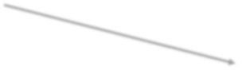


Probability - Types
Generalized Probability Tree
A
P(B and A) = P(B) * P(A|B)
P(A|B)
B
P(B)
P(A’|B)
A’
P(B and A’) = P(B) * P(A’|B)
A
P(B’ and A) = P(B’) * P(A|B’)
P(B’)
P(A|B’)
B’
P(A’|B’)
A’
P(B’ and A’) = P(B’) * P(A’|B’)
State each probability in English; note B’ means “not B”.

Slide 47
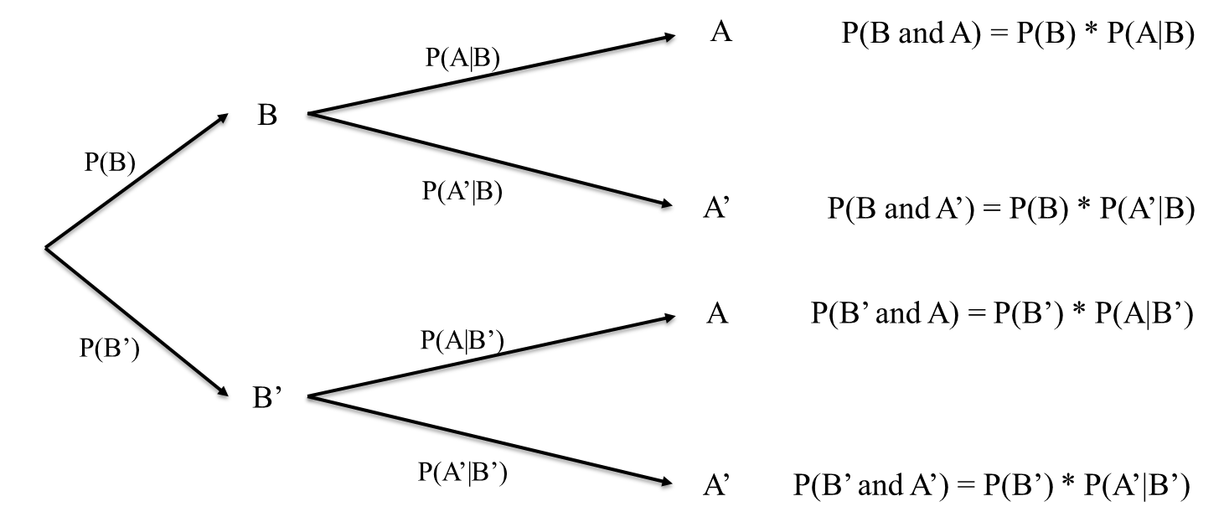
Probability - Types
Conditional Probability -> Bayes’ Theorem
𝑃 𝐵 ∗ 𝑃(𝐴|𝐵)
𝑃 𝐴 𝐵 ∗ 𝑃(𝐵)
𝑃 𝐴 𝐵 ∗ 𝑃 𝐵 + 𝑃 𝐴 𝑛𝑜𝑡 𝐵 ∗ 𝑃(𝑛𝑜𝑡 𝐵)
𝑃 𝐵 𝐴 =
=
𝑃(𝐴)
Note B’ means “not B”

Slide 48
Bayes’ Theorem
Bayes’ Theorem allows you to find reverse probabilities, and to allow revision of original probabilities with new information.
Case – Clinical trials
Epidemiologists claim that probability of breast cancer among Caucasian women in their mid-50s is 0.005. An established test identified people who had breast cancer and those that were healthy. A new mammography test in clinical trials has a probability of 0.85 for detecting cancer correctly. In women without breast cancer, it has a chance of 0.925 for a negative result. If a 55-year-old Caucasian woman tests positive for breast cancer, what is the probability that she in fact has breast cancer?

Slide 49
Case – Clinical trials P(Cancer) = 0.005
Bayes’ Theorem
P(Test positive | Cancer) = 0.85 (aka Prior Probability) P(Test negative | No cancer) = 0.925
P(Cancer | Test positive) = ? (aka Posterior or Revised Probability)
𝑃 𝐶𝑎𝑛𝑐𝑒𝑟 ∗ 𝑃(𝑇𝑒𝑠𝑡 + |𝐶𝑎𝑛𝑐𝑒𝑟)
𝑃 𝐶𝑎𝑛𝑐𝑒𝑟 𝑇𝑒𝑠𝑡 + =
𝑃 𝑇𝑒𝑠𝑡 + 𝐶𝑎𝑛𝑐𝑒𝑟 ∗ 𝑃 𝐶𝑎𝑛𝑐𝑒𝑟 + 𝑃 𝑇𝑒𝑠𝑡 + 𝑁𝑜 𝑐𝑎𝑛𝑐𝑒𝑟 ∗ 𝑃(𝑁𝑜 𝑐𝑎𝑛𝑐𝑒𝑟)
0.005 ∗ 0.85 0.00425
=
= = 0.054
0.85 ∗ 0.005 + 0.075 ∗ 0.995 0.078875
Homework
Draw a Probability Table and a Probability Tree for the above case.

Slide 50

Case – Spam filtering
Bayes’ Theorem
SpamAssassin 3.4.1 has been released! Highlights include:
improved automation to help combat spammers that are abusing new top level domains;
tweaks to the SPF support to block more spoofed emails;
increased character set normalization to make rules easier to develop and stop spammers from using alternate character sets to bypass tests;
continued refinement to the native IPv6 support; and
improved Bayesian classification with better debugging and attachment hashing.
SpamAssassin works by having users train the system. It looks for patterns in the words in emails marked as spam by the user. For example, it may have learned that the word “free” appears in 20% of the mails marked as spam, i.e., P(Free | Spam) = 0.20.
Assuming 0.1% of non-spam mail includes the word “free” and 50% of all mails received by the user are spam, find the probability that a mail is spam if the word “free” appears in it.

Slide 51
Case – Spam filtering
Bayes’ Theorem
P(Spam) = 0.50
P(Free | Spam) = 0.20 (aka Prior Probability) P(Free | No spam) = 0.001
P(Spam | Free) = ? (aka Posterior or Revised Probability)
𝑃 𝑆𝑝𝑎𝑚 ∗ 𝑃(𝐹𝑟𝑒𝑒|𝑆𝑝𝑎𝑚)
𝑃 𝑆𝑝𝑎𝑚 𝐹𝑟𝑒𝑒 =
𝑃 𝐹𝑟𝑒𝑒 𝑆𝑝𝑎𝑚 ∗ 𝑃 𝑆𝑝𝑎𝑚 + 𝑃 𝐹𝑟𝑒𝑒 𝑁𝑜 𝑠𝑝𝑎𝑚 ∗ 𝑃(𝑁𝑜 𝑠𝑝𝑎𝑚)
0.5 ∗ 0.2 0.1
=
= = 0.995
0.2 ∗ 0.5 + 0.001 ∗ 0.5 0.1005
This helps the spam filter automatically classify the messages as spam.

Slide 52

A slight detour
HOW GOOD IS YOUR CLASSIFICATION?

Slide 53
Confusion Matrix
Spam filtering |  | Predicted |  | Total
 |  | Positive | Negative
Actual | Positive | 952 | 526 | 1478
 | Negative | 167 | 3025 | 3192
Total |  | 1119 | 3551 | 4670
 |  | Predicted
 |  | Positive | Negative
Actual | Positive | True +ve | False –ve | Recall/Sensitivity/True Positive Rate (Minimize False –ve)
 | Negative | False +ve | True –ve | Specificity/True Negative Rate (Minimize False +ve)
 |  | Precision |  | Accuracy, F₁ score

Slide 54
Confusion Matrix
Spam filtering |  | Predicted |  | Total
 |  | Positive | Negative
Actual | Positive | 952 | 526 | 1478
 | Negative | 167 | 3025 | 3192
Total |  | 1119 | 3551 | 4670
952
𝑅𝑒𝑐𝑎𝑙𝑙 (𝑆𝑒𝑛𝑠𝑖𝑡𝑖𝑣𝑖𝑡𝑦) = = 0.644
1478
= 0.851
952 + 3025
Which measure(s) is/are more important?
Precision
952
𝑃𝑟𝑒𝑐𝑖𝑠𝑖𝑜𝑛 =
1119
3977
𝐴𝑐𝑐𝑢𝑟𝑎𝑐𝑦 =
=
= 0.852
952 + 3025 + 526 + 167
4670
3025 3025
𝑆𝑝𝑒𝑐𝑖𝑓𝑖𝑐𝑖𝑡𝑦 =
= = 0.948
3025 + 167 3192
𝑃𝑟𝑒𝑐𝑖𝑠𝑖𝑜𝑛 ∗ 𝑅𝑒𝑐𝑎𝑙𝑙 2 ∗ 0.851 ∗ 0.644
1.096
= = 0.733
1.495
^{𝐹1 = 2 ∗} 𝑃𝑟𝑒𝑐𝑖𝑠𝑖𝑜𝑛 + 𝑅𝑒𝑐𝑎𝑙𝑙 ⁼ 0.851 + 0.644

Slide 55
Confusion Matrix
Breast cancer detection |  | Predicted |  | Total
 |  | Positive | Negative
Actual | Positive | 852 | 126 | 978
 | Negative | 67 | 1025 | 1092
Total |  | 919 | 1151 | 2070
852
𝑅𝑒𝑐𝑎𝑙𝑙 (𝑆𝑒𝑛𝑠𝑖𝑡𝑖𝑣𝑖𝑡𝑦) = = 0.871
978
= 0.927
852 + 1025
Which measure(s) is/are more important?
Sensitivity
Specificity
852
𝑃𝑟𝑒𝑐𝑖𝑠𝑖𝑜𝑛 =
919
1877
𝐴𝑐𝑐𝑢𝑟𝑎𝑐𝑦 =
=
= 0.907
852 + 1025 + 126 + 67
2070
1025 1025
𝑆𝑝𝑒𝑐𝑖𝑓𝑖𝑐𝑖𝑡𝑦 =
= = 0.939
1025 + 67 1092
𝑃𝑟𝑒𝑐𝑖𝑠𝑖𝑜𝑛 ∗ 𝑅𝑒𝑐𝑎𝑙𝑙 2 ∗ 0.871 ∗ 0.927
1.615
= = 0.898
1.798
^{𝐹1 = 2 ∗} 𝑃𝑟𝑒𝑐𝑖𝑠𝑖𝑜𝑛 + 𝑅𝑒𝑐𝑎𝑙𝑙 ⁼ 0.871 + 0.927

Slide 56
Confusion Matrix - Recent Interview Question
You have been tasked to build a classifier for cancer diagnosis. It is of high importance that patients without cancer should RARELY be diagnosed as positive (even if some patients with cancer are diagnosed wrongly as negative).
Which of the following classification models would you prefer?
(Assuming: Positive = Cancer present, Negative = Cancer absent)
Options:
True Positive Rate [which is = True Positive / Actual Positive]
True Negative Rate [which is = True Negative / Actual Negative]
• Precision [which is = True Positive / Predicted Positive]
Total Accuracy [which is = (True Positive + True Negative) / Total Population]

Slide 57

Analyzing attributes
PROBABILITY DISTRIBUTIONS

Slide 58
Histogram
A series of contiguous rectangles that represent the frequency of data in given class intervals.
How many class intervals?
Rule of thumb: 5-15 (not too many and not too few) – Diaconis rule:
(𝑚𝑎𝑥 − 𝑚𝑖𝑛)
−1 ,
𝑁𝑜. 𝑜𝑓 𝑏𝑖𝑛𝑠 =
2 ∗ 𝐼𝑄𝑅 ∗ 𝑛 3
𝑤ℎ𝑒𝑟𝑒 𝑡ℎ𝑒 𝑑𝑒𝑛𝑜𝑚𝑖𝑛𝑎𝑡𝑜𝑟 𝑖𝑠 𝑡ℎ𝑒 𝑏𝑖𝑛 − 𝑤𝑖𝑑𝑡ℎ

Slide 59
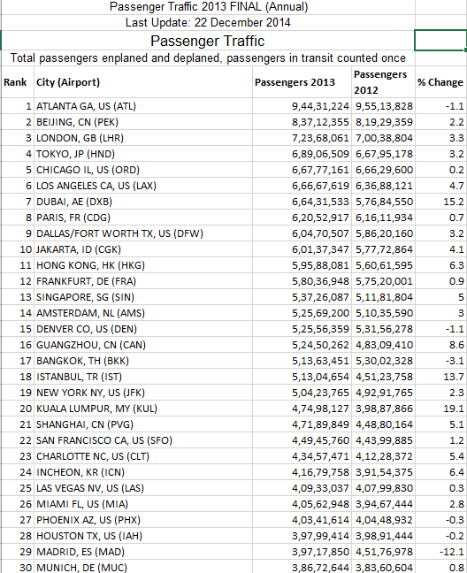
Histogram - Excel
Annual traffic data for 30 busiest airports in the world – 2013
Source: http://www.aci.aero/Data-Centre/Annual-Traffic-Data/Passengers/2013-final Last accessed: February 04, 2016

Slide 60
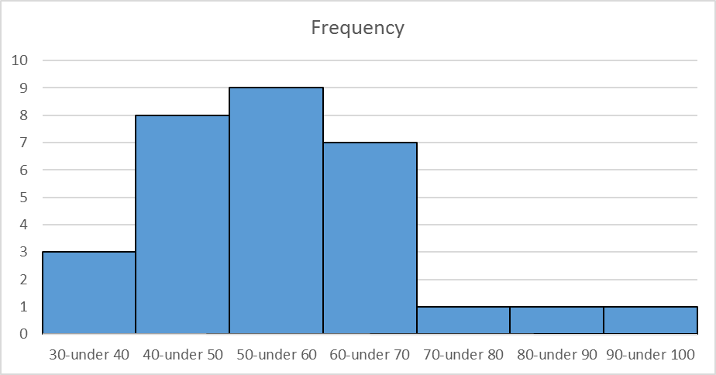
Histogram
Annual traffic data for 30 busiest airports in the world – 2013
Source: http://www.aci.aero/Data-Centre/Annual-Traffic-Data/Passengers/2013-final Last accessed: February 04, 2016

Slide 61
Stock Returns
AAPL Adjusted Stock Price
AAPL Daily Returns
0.05
120
100
0.00
80
60
-0.05
40
20
-0.10
0
Jan 04 1999
Jan 02 2003
Jan 03 2007
Jan 03 2011
Jan 02 2015
Jan 02 2013
Apr 01 2013
Jul 01 2013
Oct 01 2013
Dec 31 2013

Slide 62
Histogram of Stock Returns
Histogram of Daily Returns
300
Count
200
100
0
-0.15
-0.10
-0.05
0.00
0.05
0.10
0.15
rAAPL

Slide 63
Histogram of Stock Returns
Histogram
1000
Consider a histogram of stock returns from 5000 days
800
600
Frequency
400
200
0
-0.4
-0.2
0.0
0.2
0.4
x

Slide 64
Histogram of Stock Returns
Histogram of Returns
The same histogram with larger number of bins
200
150
Frequency
100
50
0
-0.4
-0.2
0.0
0.2
0.4
x

Slide 65
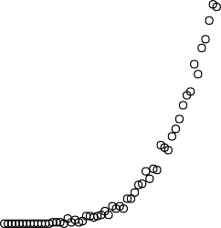
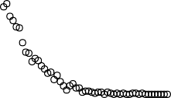
Histogram of Stock Returns
50000 data points with 200 bins
Histogram of Returns
1000
1000
800
800
Frequency
600
qq$counts
600
400
400
200
200
0
0
-0.4 | -0.2 | 0.0 | 0.2 | 0.4 | -0.4 | -0.2 | 0.0 | 0.2 | 0.4
 |  | x |  |  |  |  | qq$mids

Slide 66
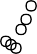

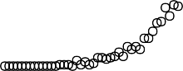
Histogram / Probability Distribution Function
Convert the counts to frequency by dividing by 50000
0.020
0.015
Frequency
0.010
0.005
0.000
-0.4
-0.2
0.0
0.2
0.4
Returns

Slide 67
Random Variable
Random Variable- a variable that can take multiple values with different probabilities.
The mathematical function describing these possible values along with their associated probabilities is called as a Probability distribution.

Slide 68
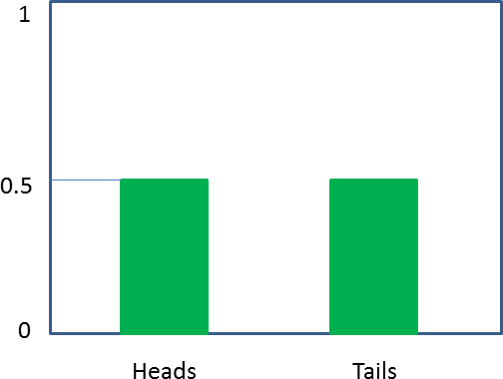
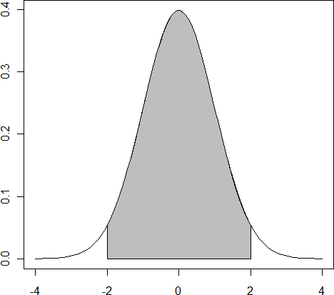
Discrete and Continuous
Countable
Measurable

Slide 69
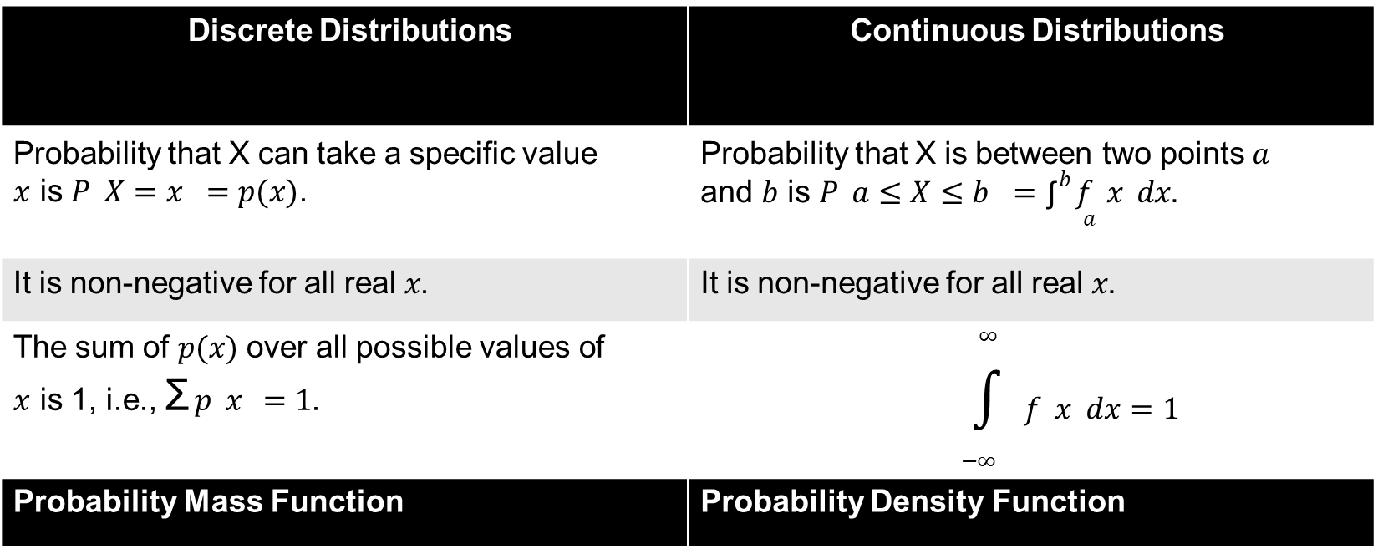
Can any function be a probability distribution?
Discrete Distributions | Continuous Distributions
Probability that X can take a specific value 𝑥 is 𝑃 𝑋 = 𝑥 = 𝑝(𝑥). | Probability that X is between two points 𝑎 and 𝑏 is 𝑃 𝑎 ≤ 𝑋 ≤ 𝑏 = ∫^{𝑏} 𝑓 𝑥 𝑑𝑥. 𝑎
It is non-negative for all real 𝑥. | It is non-negative for all real 𝑥.
The sum of 𝑝(𝑥) over all possible values of 𝑥 is 1, i.e., Σ 𝑝 𝑥 = 1. | ∞ $∫$ 𝑓 𝑥 𝑑𝑥 = 1 −∞
Probability Mass Function | Probability Density Function

Slide 70
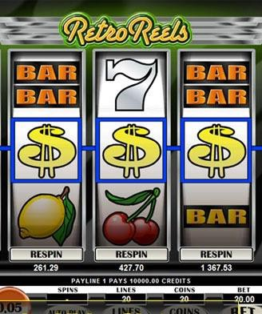



Possible Outcome | $ | Cherry | Lemon | Other
Probability of Outcome | 0.1 | 0.2 | 0.2 | 0.5
Cost: $1 for each game
Winning combinations:
= $20
= $15 (any order)
= $10
= $5

Slide 71
Probability of Winnings Combinations
Possible Outcome | $ | Cherry | Lemon | Other
Probability of Outcome | 0.1 | 0.2 | 0.2 | 0.5
Probability of Winning combinations:
= 0.1*0.1*0.1 =0.001
No win probability= ?
= 3*(0.1*0.1*0.2)=0.006
=1 – (Win something)
= 1- (0.001+0.006
+0.008 +0.008)
= 0.2 * 0.2 * 0.2 = 0.008
=0.977
= 0.2* 0.2* 0.2 = 0.008

Slide 72
Probability of Winnings Combinations
Combination | None | Lemons | Cherries | Dollars/Cherry | Dollars
Probability | 0.977 | 0.008 | 0.008 | 0.006 | 0.001
Gain | -$1 | $4 | $9 | $14 | $19
Cost: $1 for each game
Winning combinations:
= $20
= $15 (any order)
= $10
= $5

Slide 73
Probability of Winnings Combinations
Combination | None | Lemons | Cherries | Dollars/Cherry | Dollars
Probability | 0.977 | 0.008 | 0.008 | 0.006 | 0.001
Gain | -$1 | $4 | $9 | $14 | $19
Why do you need a probability distribution?
Once a distribution is calculated, it can be used to determine the EXPECTED outcome.

Slide 74
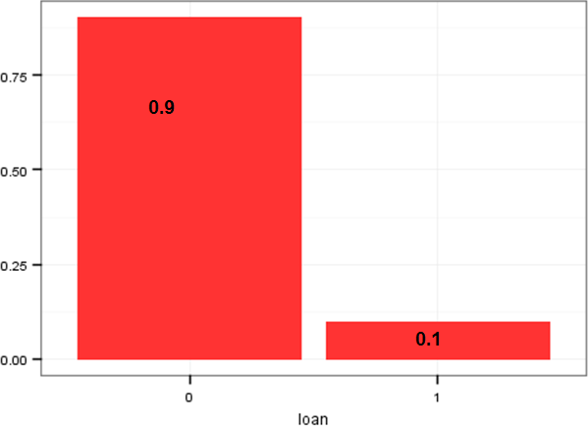
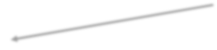

Expectation: Discrete
Recall anything like this?
𝑛
E(x) = Σ 𝑥_{𝑖}𝑃(𝑥_{𝑖})
𝑖=1
Yoga class
composition
Age (years) | 13 | 15 | 17
Frequency, f | 1 | 3 | 2
_{Mean, 𝜇 =} Σ𝑥 ₌ Σ𝑥𝑓 ₌ 13∗1+15∗3+17∗2
𝑛 Σ𝑓 1+3+2
1 3
6 6
2
6
= 13 ∗
+ 15 ∗ + 17 ∗
= 15.3
Recall Assigning Probabilities using Empirical or Frequentist Method

Slide 75
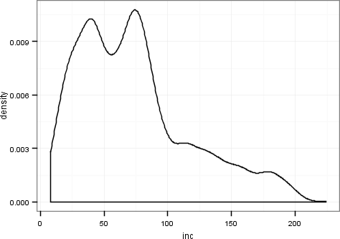
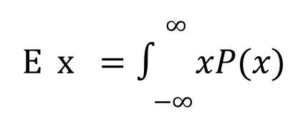
Expectation: Continuous
∞
E x = $∫$ 𝑥𝑃(𝑥)
−∞

Slide 76
Probability Distribution of Winnings
Combination | None | Lemons | Cherries | Dollars/Cherry | Dollars
P(X=x) | 0.977 | 0.008 | 0.008 | 0.006 | 0.001
x | -$1 | $4 | $9 | $14 | $19
EXPECTATION, Ε (𝑋) = 𝜇 = Σ𝑥𝑃(𝑋 = 𝑥)
E(X) = (-$1)*0.977 + $4*0.008 + $9*0.008 + $14*0.006 + $19*0.001
= -$0.77
This is the amount of $ expected to be “gained” on each pull of the lever.
So, why play?
It never makes sense to play the Slot machine or the Lottery.
Until it does!

Slide 77

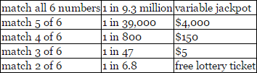
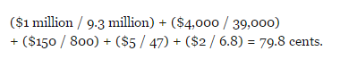
Massachusetts State Lottery
Cost of the ticket = $2
Jackpot value = Atleast $1Million
It does not make sense to play!
E(x)=

Slide 78
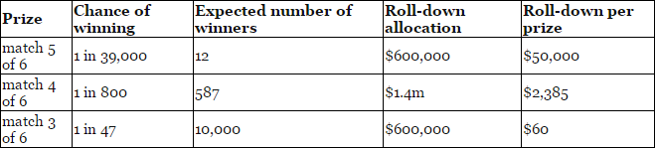
Massachusetts State Lottery
RollDay - When the Jackpot increases to $2M, then prize money for Match 5 also increases
Expected value on the roll day changes dramatically. E(x) = $5.53
See: http://www.theatlantic.com/business/archive/2016/02/how-mit-students-gamed-the-lottery/470349/

Slide 79
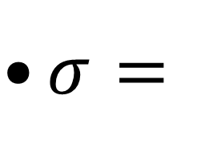
Variance of the Distribution
The Width/Spread of the distribution
VARIANCE, 𝑉𝑎𝑟(𝑋) = 𝐸(𝑋 − 𝜇)²= Σ (𝑥 − 𝜇)²𝑃(𝑋 = 𝑥)
$σ$ =
𝑉𝑎𝑟(𝑋)

Slide 80
Simplifying the Formula
𝐸[ (𝑋 − 𝜇)²]= 𝐸[𝑋² − 2𝜇𝑋 + 𝜇²]
= 𝐸 [𝑋²] − 2𝜇𝐸 [𝑋] + 𝜇²
(we get this from previous formula as 𝜇 is just a number)
= 𝐸 [𝑋²] − 2𝜇² + 𝜇²
= 𝐸 [𝑋²] − 𝜇² = 𝐸[𝑋²] − [𝐸(𝑋)]²

Slide 81
Expectation Properties
E(X+Y) = E(X) + E(Y) e.g., Playing a game each on 2 slot machines with different probabilities of winning. This is called Independent Observation.
E(aX+b) = aE(X)+E(b) = aE(X) + b e.g., values x have been changed.
This is called Linear Transformation.
* Not all central tendencies posses this nice property

Slide 82
Variance Properties
Var(X+a) = Var(X) (Variance does not change when a constant is added)
For Independent Observations
: Var(X+Y) = Var(X) + Var(Y)
: Var(X-Y) = Var(X) + Var(Y)
(Note: the above 2 relationships do not hold if the observations are not independent)
Var(aX) = a² Var(X)

Slide 83
Understanding the shape of a PDF - Skewness
A measure of symmetry. Negative skew indicates mean is less than median, and positive skew means median is less than mean.

Slide 84
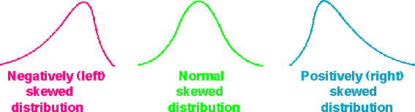
Understanding the shape of a PDF - Skewness

Slide 85
Understanding the shape of a PDF - Skewness
A measure of the ‘peaked’ness of the data distribution. Negative Excess-kurtosis means a flat distribution. Positive Excess-kurtosis means a peaked distribution.
𝐸[ 𝑋−𝜇
4]
𝐸𝑥𝑐𝑒𝑠𝑠 𝐾𝑢𝑟𝑡𝑜𝑠𝑖𝑠 =
- 3
𝜎
4

Slide 86
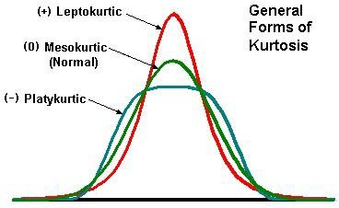
Understanding the shape of a PDF - Skewness

Slide 87
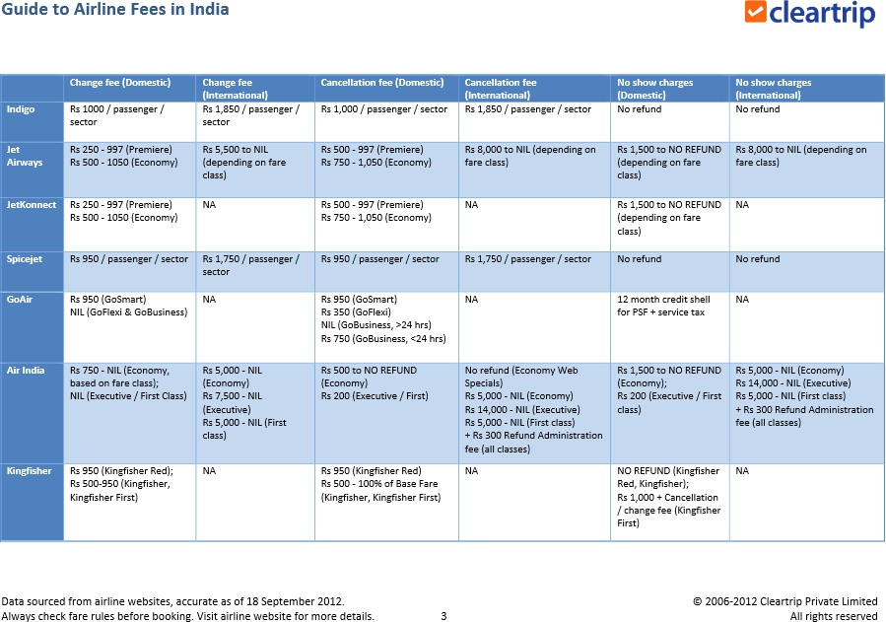
Central Tendencies and Probability Distribution from a Decision Perspective – A Real World Scenario

Slide 88
Central Tendencies and Probability Distribution from a Decision Perspective – A Real World Scenario
Kingfisher Airlines* would like to maximize revenues by ensuring no empty seats on its flight between Bengaluru and Hyderabad.
They intentionally wish to overbook the flights based on the historical data of no-shows on this sector.
You have been hired as a statistical consultant to help formulate a solution.
*currently not in business

Slide 89
Central Tendencies and Probability Distribution from a Decision Perspective – A Real World Scenario
The frequency distribution of “No-Shows” from 200 randomly selected flights on this sector is:
# of No-Shows | 1 | 2 | 3 | 4 | 5 | 6 | Total
Frequency | 70 | 40 | 10 | 20 | 20 | 40 | 200
What is your advice for Kingfisher on the number of seats they should overbook on this sector?

Slide 90
Central Tendencies and Probability Distribution from a Decision Perspective – A Real World Scenario
What is the Random Variable in this problem? Random variable, X is the # of No-Shows.
What is the PMF for the frequency distribution seen in the sample?
# of No-Shows | 1 | 2 | 3 | 4 | 5 | 6 | Total
Frequency | 70 | 40 | 10 | 20 | 20 | 40 | 200
X | 1 | 2 | 3 | 4 | 5 | 6
P(X=x) | 0.35 | 0.20 | 0.05 | 0.10 | 0.10 | 0.20

Slide 91
Central Tendencies and Probability Distribution from a Decision Perspective – A Real World Scenario
What is the Expectation?
X | 1 | 2 | 3 | 4 | 5 | 6
P(X=x) | 0.35 | 0.20 | 0.05 | 0.10 | 0.10 | 0.20
𝐸 (𝑋) = 1 ∗ 0.35 + 2 ∗ 0.20 + 3 ∗ 0.05 + 4 ∗ 0.10 + 5 ∗ 0.10 + 6 ∗ 0.20 = 3
So, you’d advise Kingfisher to overbook 3 seats on this sector, which is the mean of the data in the sample.

Slide 92
Central Tendencies and Probability Distribution from a Decision Perspective – A Real World Scenario
Scenario 1: Kingfisher tells you that it will pay you Rs 500 for your consulting and Rs 1500 as bonus for each correct prediction (prediction must be exactly correct, no more no less). Will you still go with the mean?
X | 1 | 2 | 3 | 4 | 5 | 6
P(X=x) | 0.35 | 0.20 | 0.05 | 0.10 | 0.10 | 0.20
𝐸 (𝑋) = 1 ∗ 0.35 + 2 ∗ 0.20 + 3 ∗ 0.05 + 4 ∗ 0.10 + 5 ∗ 0.10 + 6 ∗ 0.20 = 3
So, will you advise Kingfisher to overbook 3 seats on this sector, which is the mean of the data in the sample?

Slide 93
Central Tendencies and Probability Distribution from a Decision Perspective – A Real World Scenario
Scenario 1
What is the probability distribution of your earnings if you went with the expected value (or the mean)?
X (Your earnings) | 500 | 500 | 2000 | 500 | 500 | 500
P(X=x) | 0.35 | 0.20 | 0.05 | 0.10 | 0.10 | 0.20
𝐸 (𝑋) = 500 ∗ (0.35 + 0.20 + 0.10 + 0.10 + 0.20)+ 2000 ∗ 0.05 = ₹575
How much would you earn in other cases?
Would you still stick to Mean or switch to Median or Mode?

Slide 94
Central Tendencies and Probability Distribution from a Decision Perspective – A Real World Scenario
Scenario 2
Instead of a binary state for your earnings, if Kingfisher offers to pay you Rs 2000 for the consulting minus Rs 125 for each under or overbooked seat, what will be your advice now?
X (Your earnings) | 2000 | 1875 | 1750 | 1625 | 1500 | 1375
P(X=x) | 0.35 | 0.20 | 0.05 | 0.10 | 0.10 | 0.20
𝐸 (𝑋) = 2000 ∗ 0.35 + 1875 ∗ 0.20 + 1750 ∗ 0.05 + 1625 ∗ 0.10 + 1500 ∗ 0.10 + 1375 ∗ 0.20 = ₹1750
How much would you earn in other cases?

Slide 95
Central Tendencies and Probability Distribution from a Decision Perspective – A Real World Scenario
Scenario 3
Instead of penalizing based on absolute magnitude of the prediction error, if Kingfisher offers to pay you Rs 2500 for the consulting minus Rs 75 times the square of the prediction error (penalizing larger errors more), what will be your advice now?
X (Your earnings) | 2500 | 2425 | 2200 | 1825 | 1300 | 625
P(X=x) | 0.35 | 0.20 | 0.05 | 0.10 | 0.10 | 0.20
𝐸 (𝑋) = 2500 ∗ 0.35 + 2425 ∗ 0.20 + 2200 ∗ 0.05 + 1825 ∗ 0.10 + 1300 ∗ 0.10 + 625 ∗ 0.20 = ₹1907.50
How much would you earn in other cases?

Slide 96
Central Tendencies and Probability Distribution from a Decision Perspective – A Real World Scenario
Conclusion
For the same dataset, depending on the business problem, Mode was the best option in Scenario 1, Median in Scenario 2 and Mean in Scenario 3.
Moral of the story
You should look at data carefully in the context of the business domain and problem.
You must inculcate statistical way of thinking in all you do.
Statistics don’t lie; Statisticians may.
In God we Trust; all others must bring data.

Slide 97
Useful Resources
Conditional probability explained visually https://www.khanacademy.org/video/conditional-probability2
Bayes Theorem : https://youtu.be/E4rlJ82CUZI
Creating a histogram: https://www.khanacademy.org/video/histograms-intro
Probability Distribution Functions
https://www.khanacademy.org/video/discrete-probability-distribution
https://www.khanacademy.org/video/probability-density-functions

